Slide 1












IPLGPT
Where Authentic Tea Meets AI-Powered IPL Chatbot!

Slide 2






UNVEILING THE BILLIONAIRES BEHIND IPLGPT
MR. ​
DHANANJAY GHATE​
MS.
NEENA CHAUDHARI
MS. ​
PURVI BHARANI​
MR. ​
SHRAVAN HONADE​

Slide 3











TABLE OF CONTENT
All
About Data
Business
Problem
Why IPLGPT?
Tech-Stack​
Used​
ETL &
Workflows
RAG
Architecture
User Experience
Demo
Analytics
AI Agents

Slide 4
BUSINESS PROBLEM
Fan's Engagement
Fantasy sport support
Interactive quizzes and trivia
Fan community building
Increase brand presence
FIRST EDITION
2008
FORMAT
T20
NUMBER OF TEAMS
10
ADMINISTRATOR
BCCI
HEADQUARTERS
MUMBAI, MAHARASHTRA

Slide 5




WHY IPLGPT?​

Slide 6
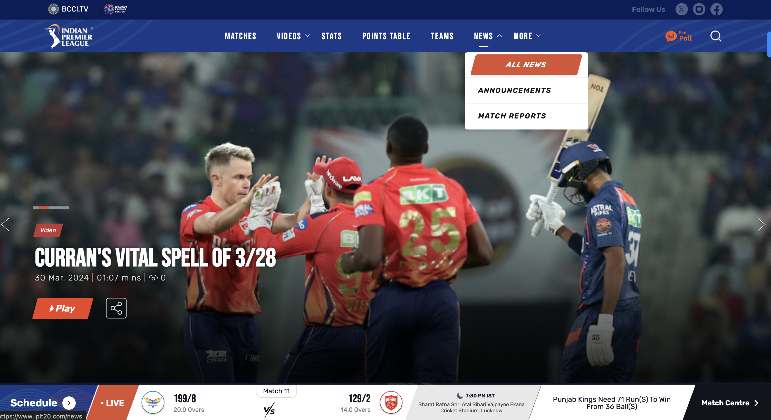

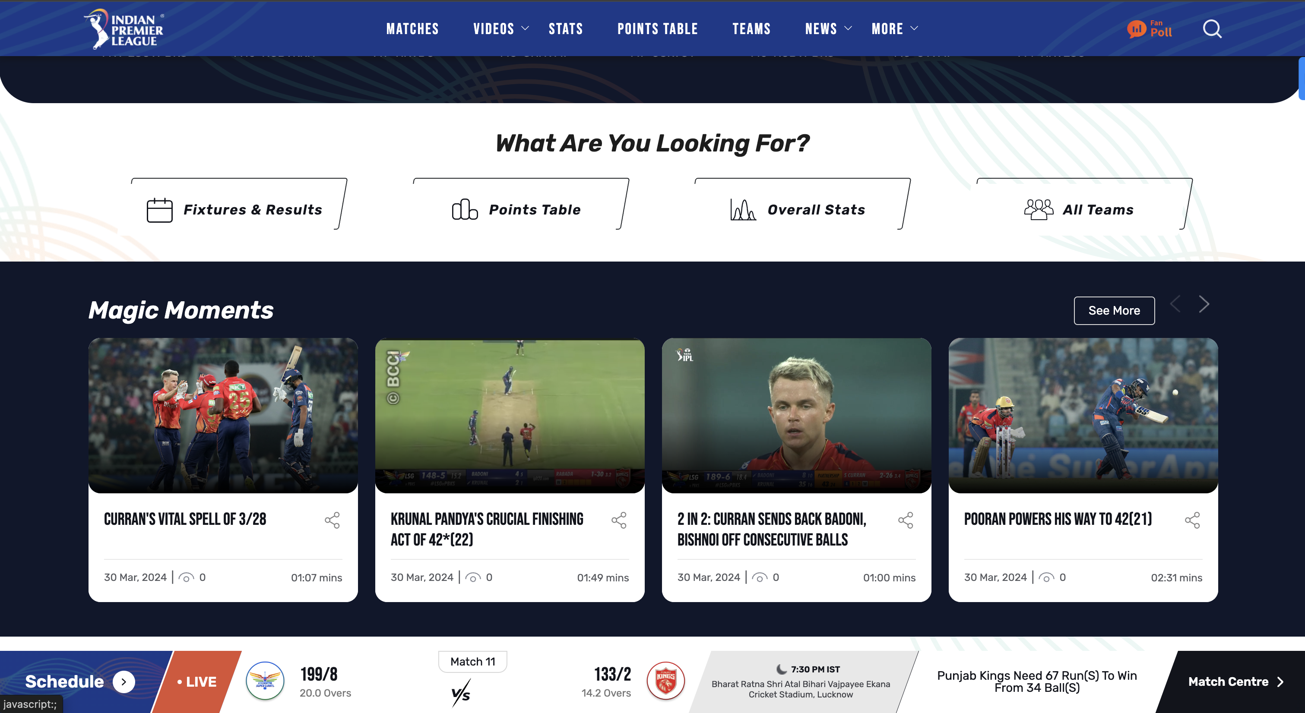

DATA SOURCES
Indian Premier League Official Website -2024:
https://www.iplt20.com/
CricTracker: Cricket Live Score, Cricket News, Predictions, Stats:
https://www.crictracker.com/
DATA SOURCES

Slide 7

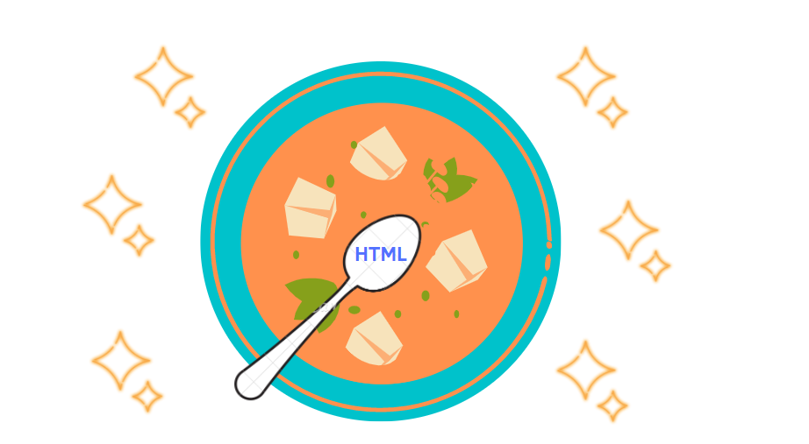

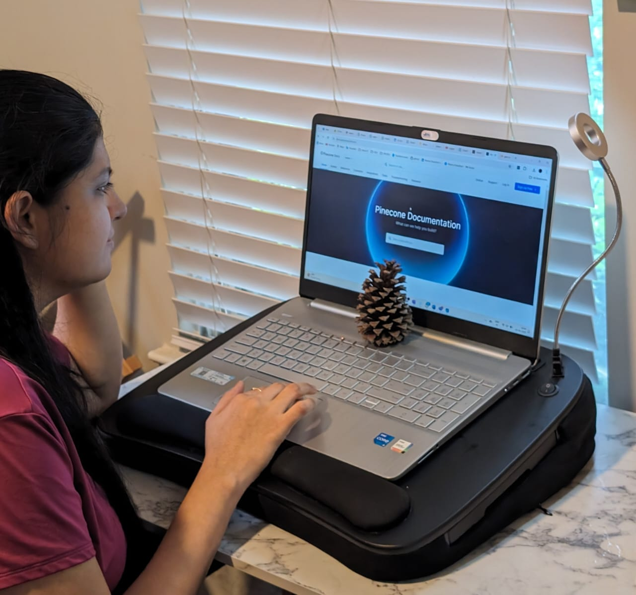



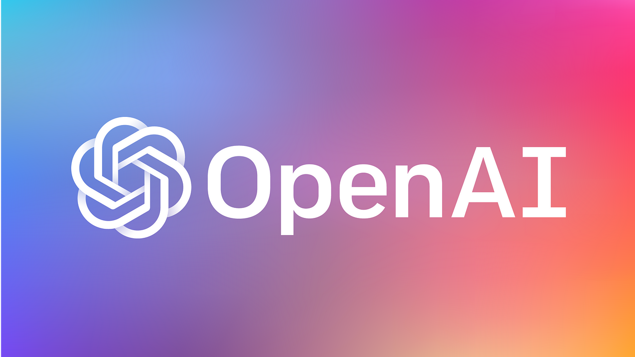


TECH-STACK USED
BEAUTIFUL SOUP
LANGCHAIN
AWS S3 BUCKET
PINECONE
EMBEDDINGS API - text-ada-002 LLM API - GPT-3.5-turbo
AWS GLUE
TABLEAU
STREAMLIT
Notes:
Data scraping using beautiful soup to extract data from website.
Storage solution to used to store the scraped and transformed data.
Used AWS glue for ETL process to ensure data quality
Tableau for EDA and data visualization
Langchain – framework - Langchain likely provides a framework that simplifies the integration and implementation of Language Models like GPT-3.5-turbo into applications.
Pinecone – cloud based vector db to get the most similar and accurate results using vector indexing and nearest neighbour search - And there's me, working hard with Pinecone!
AI models – used LLM API GPT 3.5 from OpenAI embedded along with history to maintain the user's conversation
Streamlit – to develop interactive UI for chatbot

Slide 8

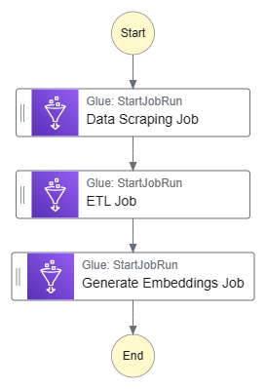
WORKFLOW
SOURCE
CLEANED FOLDER
LANDING FOLDER
PROCESSED FOLDER
Notes:
AWS step function – for orchestration and streamlining of data processing pipeline
3 glue jobs – scraping, ELT, and embeddings jobs
In terms of data processing, we adopted a structured approach using the 'bronze, silver, gold' framework. This allowed us to categorize our data into raw (bronze), cleaned (silver), and processed (gold) stages, ensuring that each piece of data received the appropriate level of refinement and quality control.

Slide 9






ETL ARCHITECTURE
DATA SOURCES
AWS GLUE JOB
DATA TARGET
TRANSFORMS
RUNS SCRIPTS
LOADS
EXTRACTS
AMAZON S3
AMAZON S3
TRIGGERS
SCHEDULE OR EVENT
Notes:
Hyperlinks, mentions of twitter, emojis and images

Slide 10
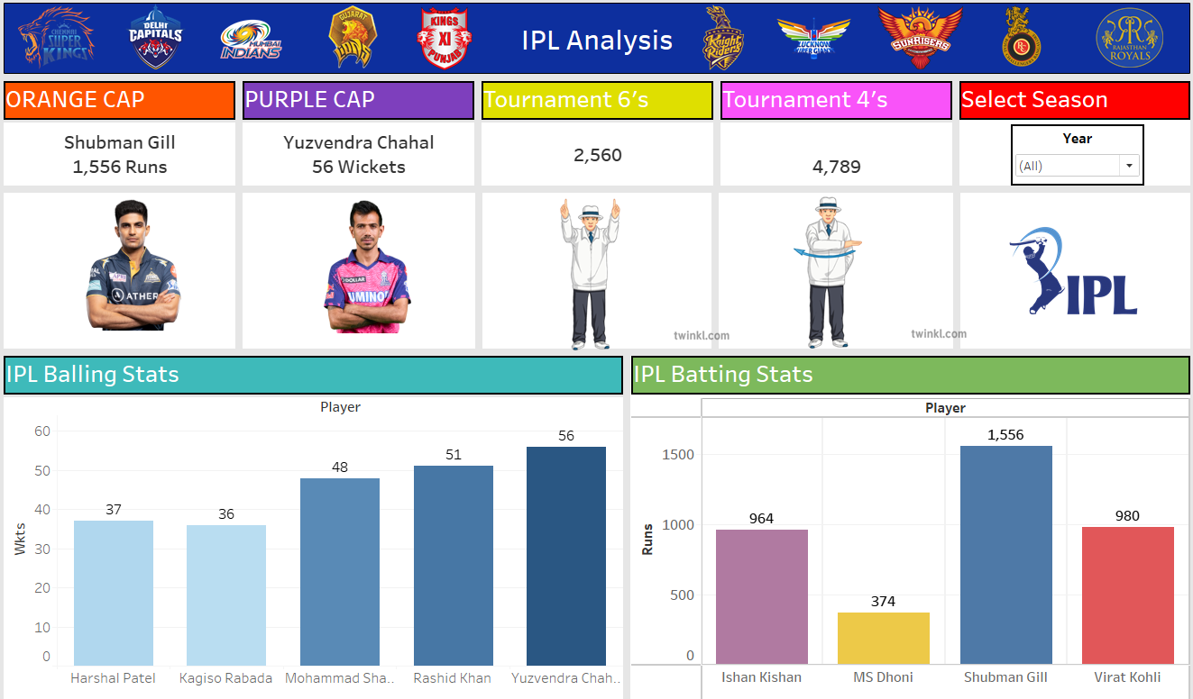
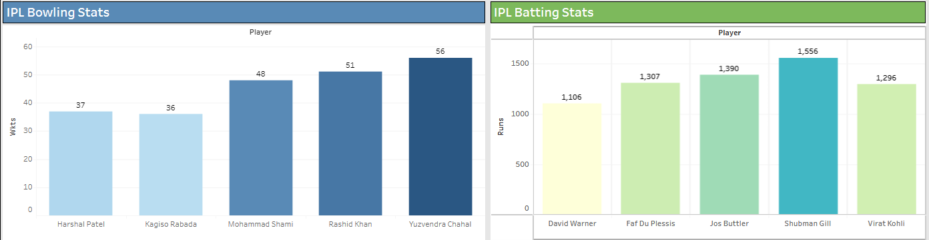
ANALYTICS
Tableau Dashboard Link
Notes:
Here is a quick fact: Did you know that organizations using data visualization tools like Tableau are 5.3 times more likely to find timely insights than those relying solely on spreadsheets
Interactive dashboard for EDA and data visualization
structured db – 2 csv file scraped from the official ipl website
Batters and Bowler csv
We can check if our delta logic is fetching latest data
3 season data – 2022,2023,2024

Slide 11
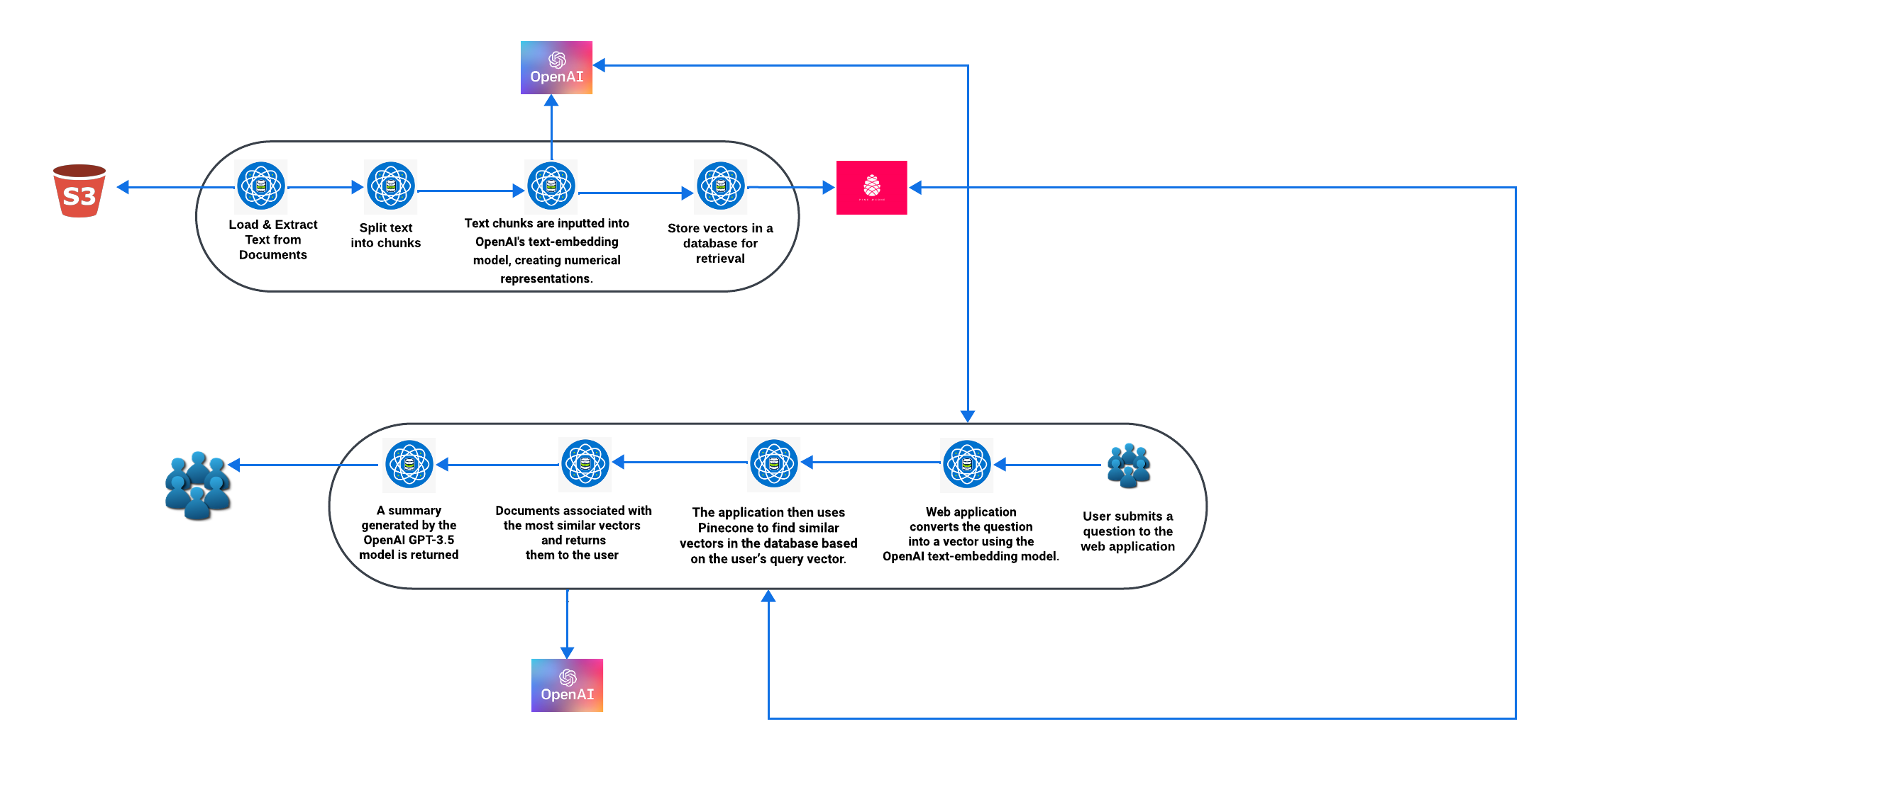
RAG ARCHITECTURE

Slide 12


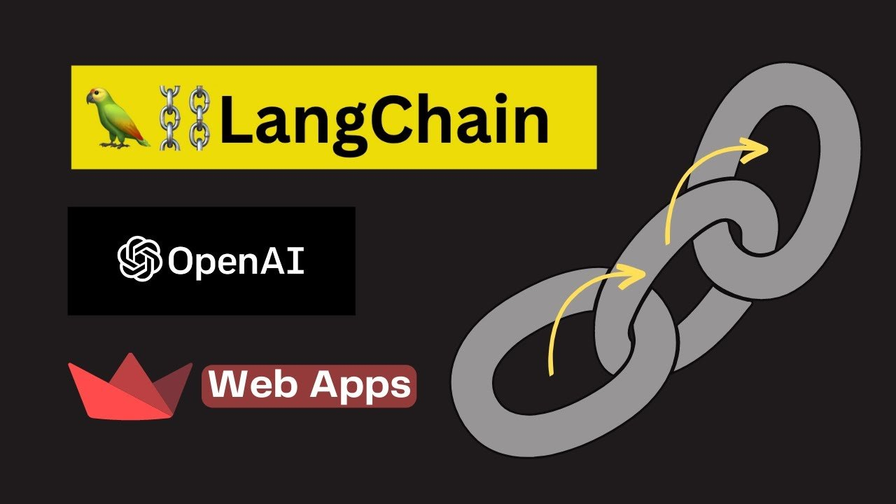
Streamlit's interactive interface to capture user queries and display chatbot responses.
Preprocessing user queries using LangChain to improve understanding and accuracy.
Retrieving real-time IPL data from Open API endpoints based on user queries.
Displaying the retrieved information and chatbot responses in the Streamlit interface for seamless user interaction.
BUILDING OUR IPLGPT​ UI
Streamlit's interactive interface to capture user queries and display chatbot responses.
Preprocessing user queries using LangChain to improve understanding and accuracy.
Retrieving latest IPL updates based on user queries.
Displaying the retrieved information and chatbot responses in the Streamlit interface for seamless user interaction.

Slide 13

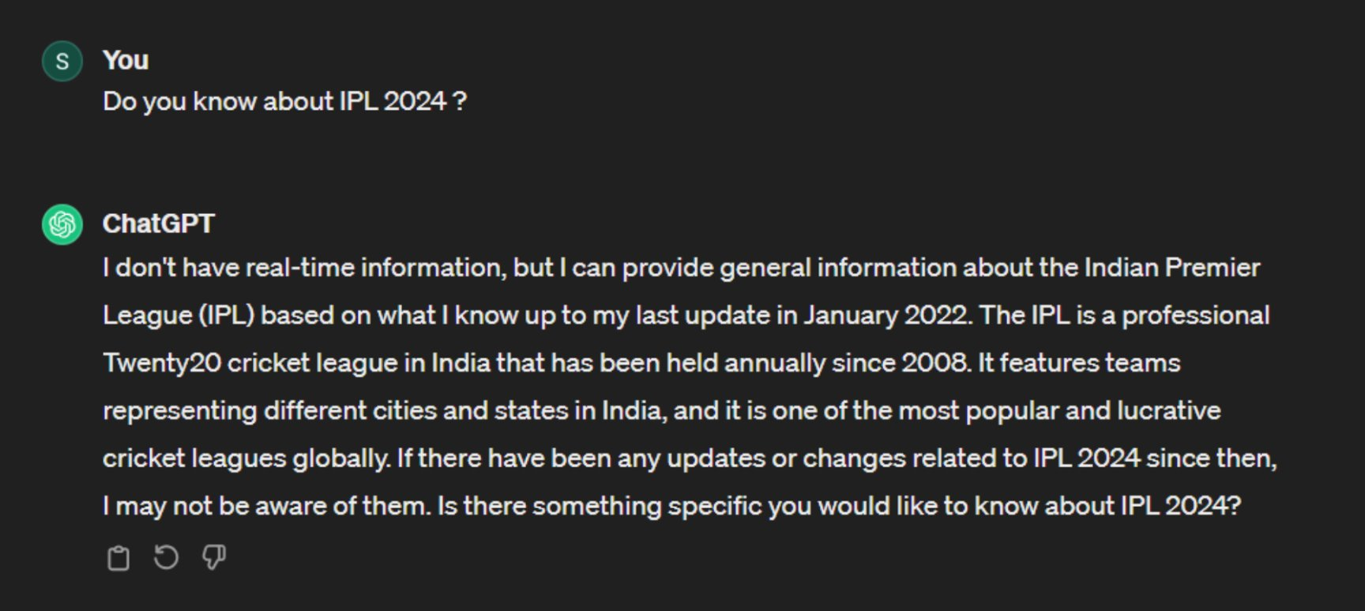
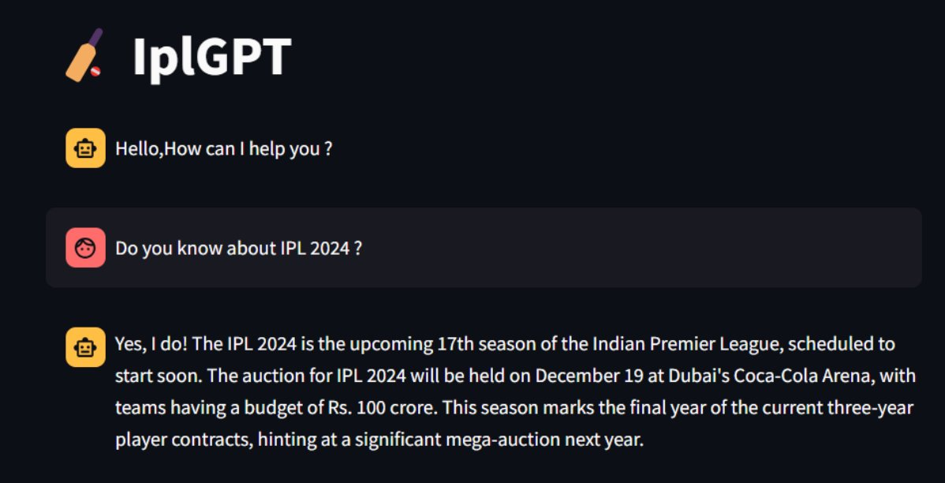
LET'S CHAT!

Slide 14
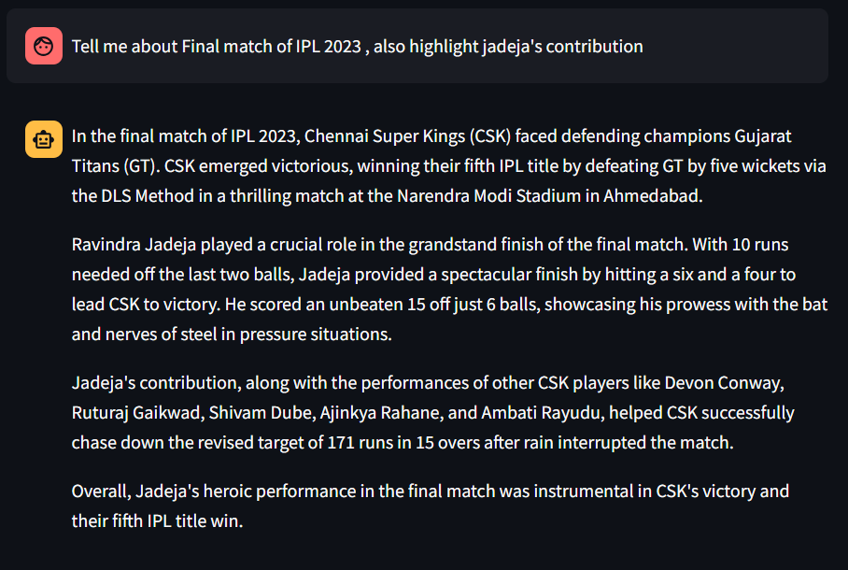
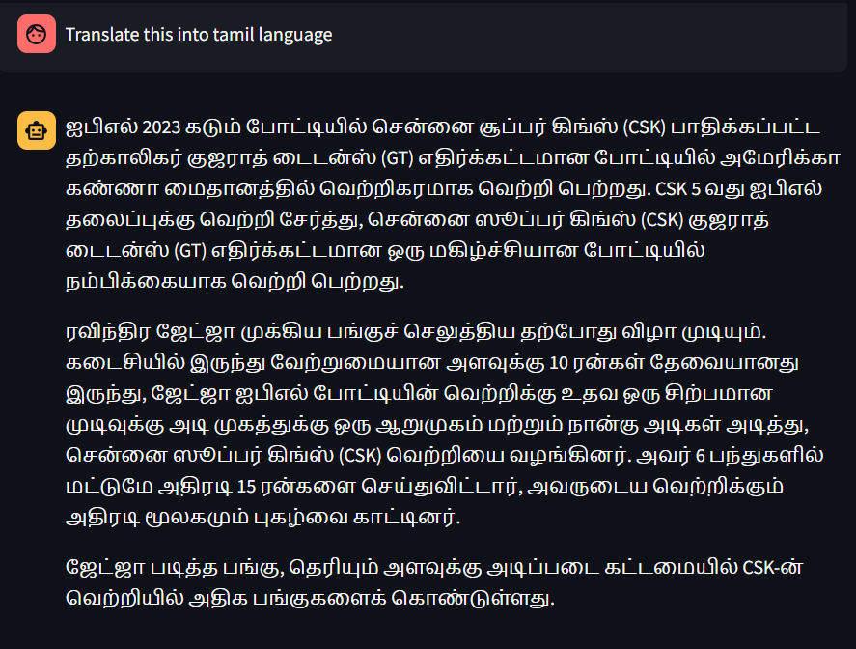
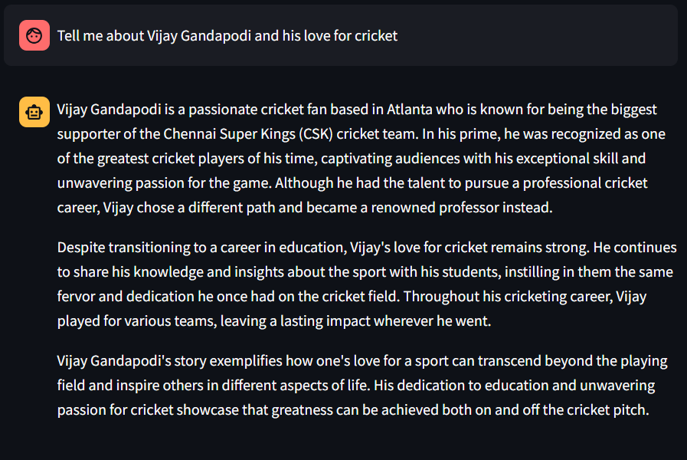
LET'S DIG DEEPER INTO HOW THIS MARVEL WORKS!

Slide 15
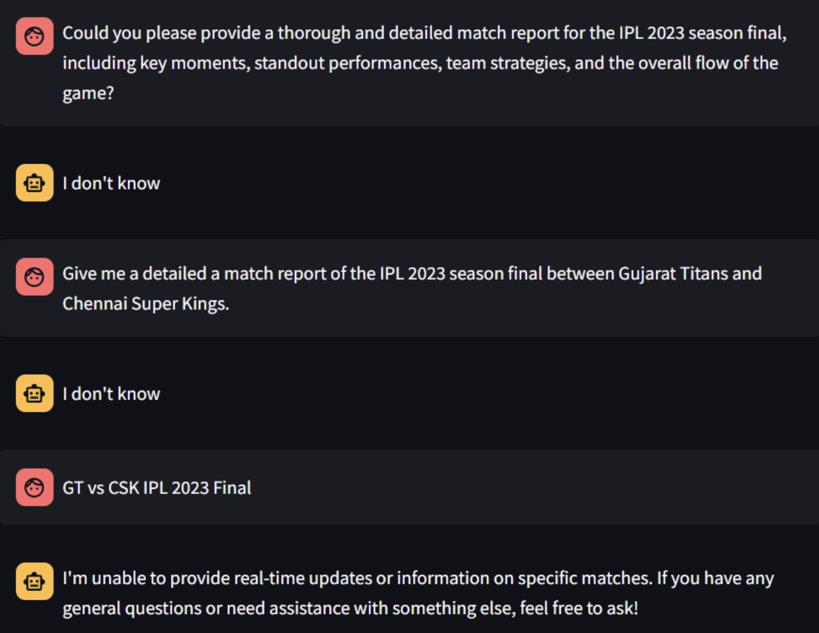
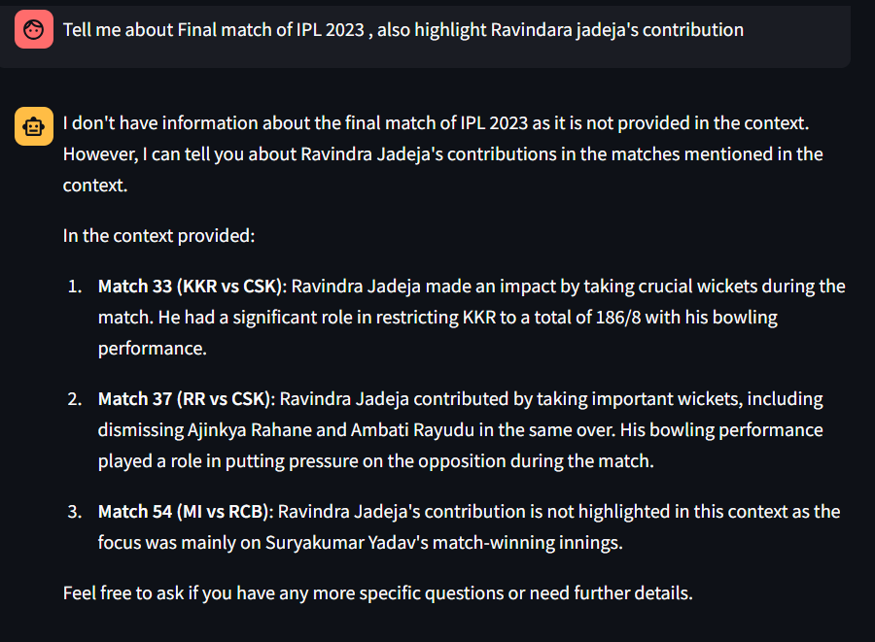
CHALLENGES

Slide 16
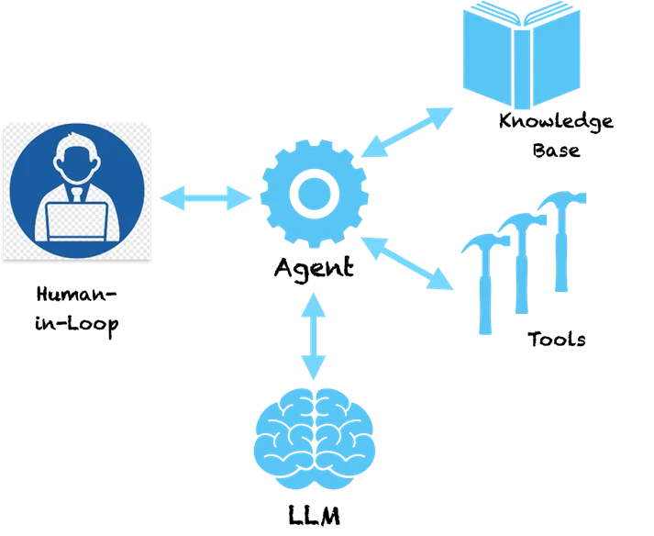
AI AGENTS
Knowledge-Base
Agent
Human in loop
Tools
LLM

Slide 17

EXPERIENCE THE FUSION
Join us at IPL GPT to savor the essence of tea and cricket, seamlessly integrated with cutting-edge AI features.

Slide 18
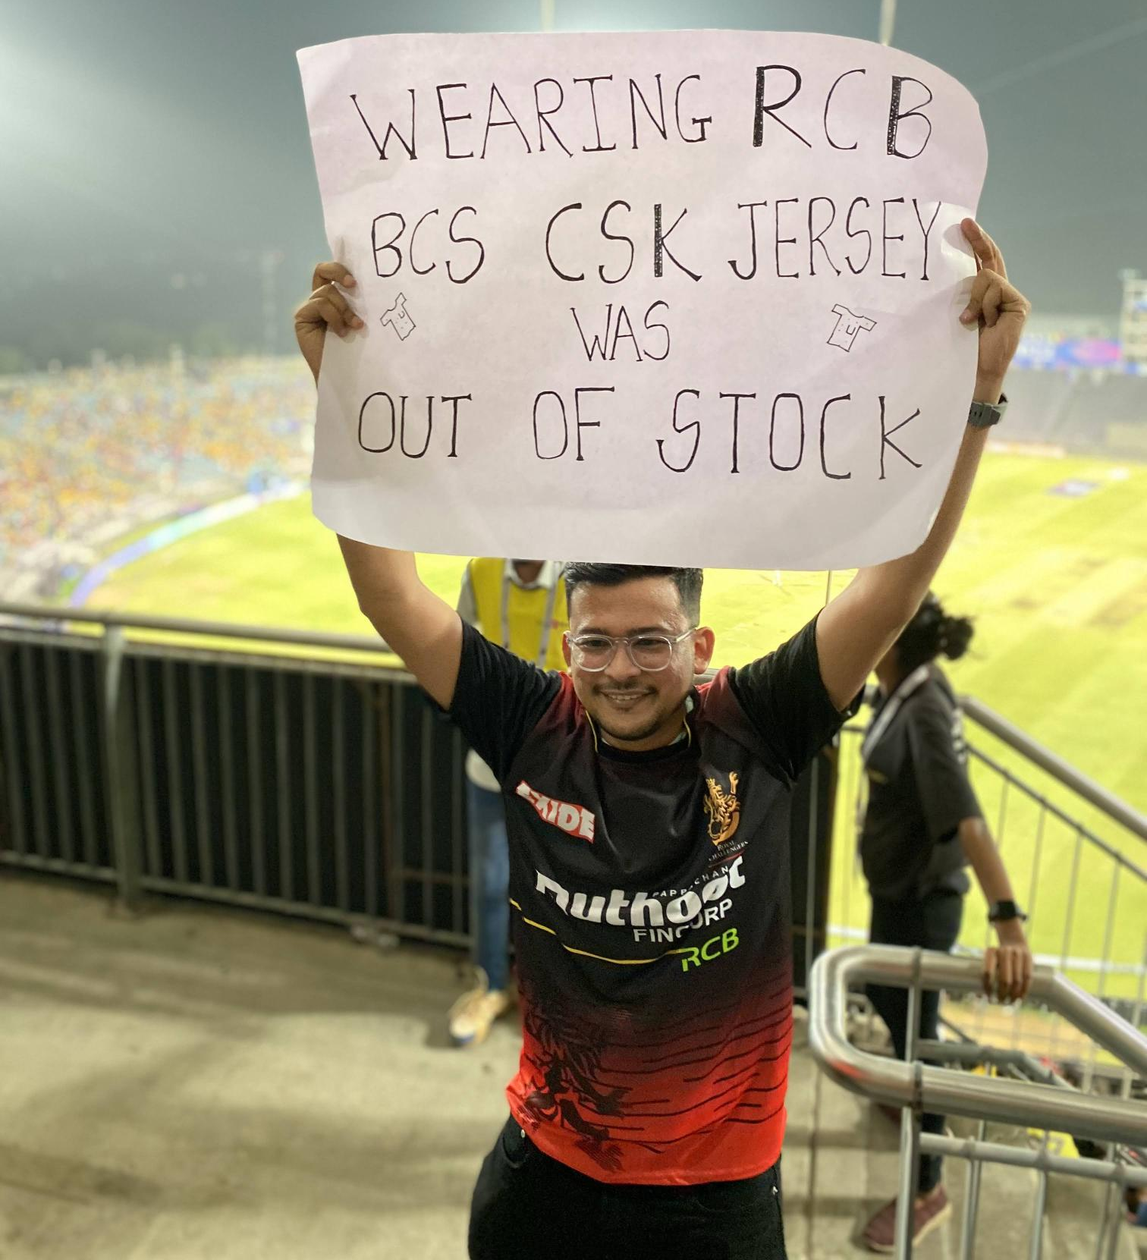
REFERENCES
https://beautiful-soup-4.readthedocs.io/en/latest/
What is AWS Glue? - AWS Glue (amazon.com)
AWS Step Functions Documentation (amazon.com)
AWS SDK for Python (Boto3) Documentation (amazon.com)
https://python.langchain.com/doc
https://docs.streamlit.io/
https://platform.openai.com/docs/api-reference
https://www.youtube.com/@underfitted
https://www.youtube.com/@freecodecamp
https://platform.openai.com/docs/guides/embeddings

Slide 19

THANK YOU !
ANY QUESTIONS?

